Slide 1
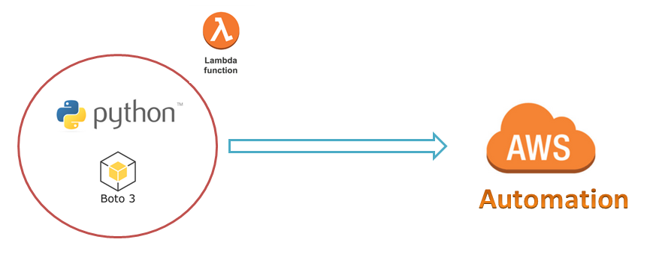
AWS Automation
with
boto3 of Python and Lambda Functions
Boto3 Collection Concept to start, stop, terminate required Instances at once
Loop control statements or commands
(break and continue)
Learn how to automate AWS common tasks using boto3 and Lambda

Slide 2
Thank you

